Slide 1
Lecture 16. Phase Transformations (Phase Separation) in Binary Mixtures (Ch. 5)
So far, we have been considering phase transformations (phase separation) in the systems with a single type of particles. Consequences: the energy of intermolecular interactions is the same for all the molecules, and the entropy is reduced because of the indistinguishability of particles. The behavior of a system becomes more complicated when the system contains two or more types of particles (aka mixtures).
A mixture is homogeneous when its constituents are intermixed on the atomic scale (it is also colled solution).
A mixture is heterogeneous when its contains two or more distinct phases, such as oil and water that do not mix at normal T, each phase has different concentrations of intermixed atoms/molecules (phase separation).
Difference from chemical compounds: concentrations of components are not mutually locked, they can vary over a wide range. However, interactions between molecules do play an important part in forming a mixture. For example, forming a mixture usually leads to releasing or absorbing some heat (typically, this energy is only an order of magnitude less than the heat released in chemical reactions). Also, the volume of a mixture may differ from the sum of volumes of starting compounds (e.g., mixture of water and ethanol has a smaller volume than the sum of starting volumes).
Our goal is to find out how the free energy minimum principle governs the behavior of mixtures.

Slide 2







Coexistence of Phases, Gibbs Phase Rule
The complexity of phase diagrams for multicomponent systems is limited by the “Gibbs’ phase rule”. This restriction on the form of the boundaries of phase stability applies also to single-component systems.
Let’s consider a mixture of k components, and assume that the mixture consists of N different phases. For a multi-component system, the # of different phases might be > 3 (these phases might have different concentrations of components). In equilibrium, and the values of chemical potential for each component must be the same in all phases:
k(N-1) equations
.....
N equations
(in each phase, the sum of all concentrations = 1)
The lower index refers to a component, the upper index – to the phase. Each phase is specified by the concentrations of different components, x_{i}^{j}. The total number of variables: , equations: . In general, to have a solution, the # of equations should not exceed the # of variables. Thus:
For a single-component system (k=1), either two or three phases are allowed to be in equilibrium (but not four). Coexistance of three phases – the triple point.

Slide 3



Binary Mixtures
Phase diagram of a binary mixture
T
Mixing is a complicated process, and both the basic science and applications of mixing are very rich (chemistry, metallurgy, etc.). We will just scretch the surface of this problem using a number of simplifications:
(a) We’ll consider only binary mixtures. A binary mixture consists of two types of molecules, A and B, x is the fraction of B molecules (if the particles are atoms, and not molecules, the mixture is called an alloy.) The phase diagram for such a system (in comparison with the phase diagram for a single-component system) has an extra dimension – x.
x
P
P = const planes
Boundary between different phases
(b) We assume that the process of mixing accurs at fixed T,P within a fixed volume V. In this case, it does not matter which free energy we minimize - both F and G work equally well.
- a mixture will seek the state of equilibrium by minimizing this combination of its internal energy and entropy. We need to analyze both terms.

Slide 4
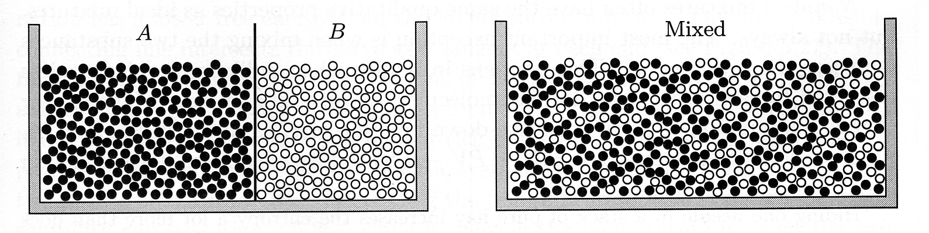


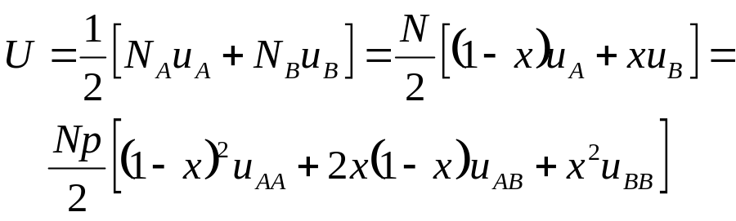
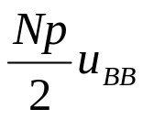
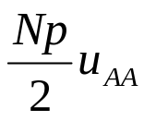
Interaction Energy in Binary Mixtures
Let’s assume that the mixture is in a solid state, both species share the same lattice structure. Consider N_{A} atoms of species A and N_{B} =N - N_{A} atoms of species B (x = N_{B}/N).
Each atom has p nearest neighbors. Let u_{AA}, u_{AB}, u_{BB} represent the bond energy between A-A, A-B, and B-B pairs, respectively. On the average, an A atom is involved in p(1-x) interactions of A-A type and px interactions of A-B type.
The average interaction energy per A atom:
The average interaction energy per B atom:
The total interaction energy:
(the factor ½ corrects the fact that each bond has to be counted just once)
The overall shape of U(x) depends on the interactions between different species:
U
0
1
x

Slide 5
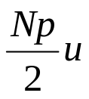
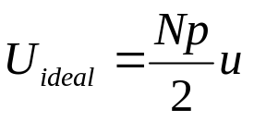
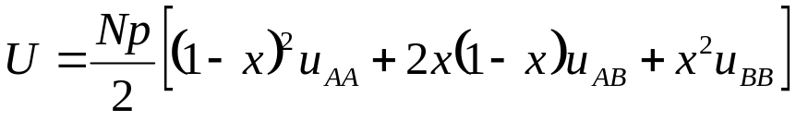
Ideal and Non-Ideal Mixtures
Ideal mixtures – the molecules A and B are of the same size and interactions A-A, A-B, and B-B are identical (u_{AA}=u_{AB}=u_{BB}=u ):
U
Ideal mixture
- does not depend on x
0
1
x
In real (non-ideal ) mixtures of liquids and solids, the interactions A-A, A-B, and B-B might be very different (e.g., the water and oil molecules: water molecules carry a large dipole moment that leads to a strong electrostatic attraction between water molecules; in oil molecules this dipole moment is lacking).
To be specific, we’ll consider the case of a non-ideal mixture when unlike molecules are less attracted to each other than are like molecules (u_{AB} > u_{AA}= u_{BB}). Mixing of the two substances increases the total energy. (Note the sign of u: it’s negative for attraction)
U
0
1
x
As we’ll see, the fact that U has an upward bulge will have important consequences for phase separation in this mixture.

Slide 6
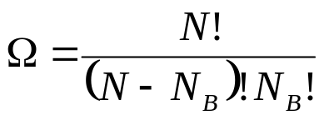
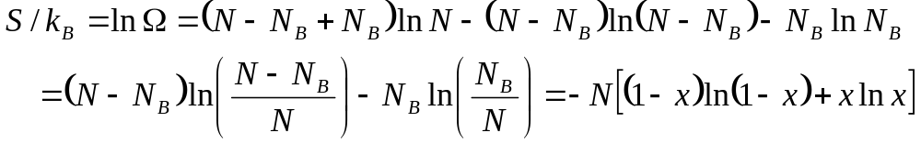
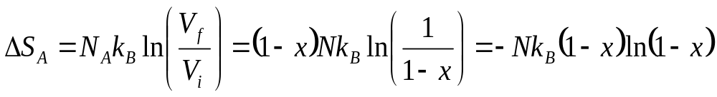
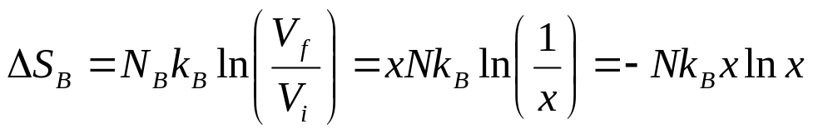
Entropy of a Binary Mixture
The total number of ways of distributing the two species of atoms over the lattice sites:
S
The same result we get by considering the entropy of mixing for a system of two ideal gases (Pr. 2.37). Initially, gas A occupies portion (1-x) of the total volume, gas B – portion x. When the partition is removed, molecules A and B are intermixed over the whole volume:
concave-downward
function
0
x →
1
pure A
pure B
the slope is infinite at both ends, and therefore the entropy of mixing is going to be the dominant factor near x=0 and x=1.
Similarly, for gas B:
The total entropy increase upon mixing:

Slide 7
Free Energy of Mixtures
Ideal Mixtures, U ≠ U(x)
F
- we assume that the process of mixing accurs at fixed T,P within a fixed volume V
T₁
<
T₂
In the ideal mixtures [U ≠ U(x)], the F(x) curve is concave at all T. This means that if we prepare a mixture at a fixed x, it remains homogeneous at all T. A macroscopic phase separation in this system would lead to an increase of F. An example: mixtures of two gases are always homogeneous, because the intermolecular interactions are weak, and the curvature of S(x) always dominates over a small (if any) curvature of U(x).
0
1
x
Non-Ideal Mixtures U = U(x)
U
0
1
x
For non-ideal mixtures, there is a serious competition between the positive term ΔU and the negative term -TΔS. At T ≠ 0, the latter term always wins the competition close to the end points, where the entropy of mixing has an infinite derivative (at any finite T there is a finite solubility of A in B and B in A).
As a result, in non-ideal mixtures with U(x) like on the plot, at T<T_{C}, there is an upward bulge in the mid range of x which suggests instability.
-S
0
1
x
T<T_{C}
F
T>T_{C}
0
x₁
x₂
1
x

Slide 8
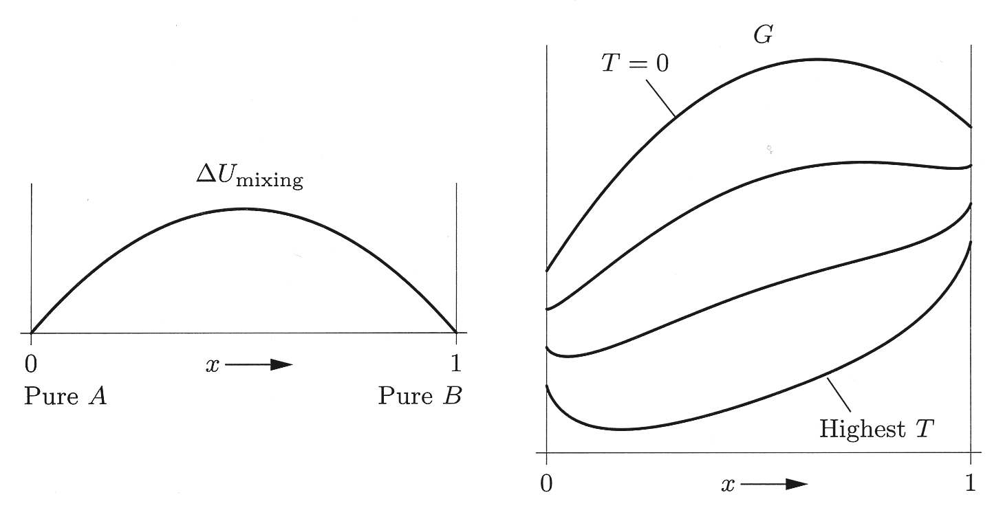
Phase Separation in Liquid and Solid Mixtures
The upward bulge on the dependence F(x) for non-ideal mixtures in the mid range of x suggests that the system becomes unstable agains macroscopic phase separation (same instability that we saw in the van der Waals theory, but now as a function of x, not V). A common tangent touches F(x) at x₁ and x₂. When the system is cooled below the critical temperature T_{C}, the system splits into two different spacially separated mixtures, one mixed at the ratio x₁ and the other mixed at the ratio x₂.
A mixture exhibits a solubility gap when the combined free energies of two separate (spacially separated) phases is lower than the free energy of the homogeneous mixture. The misicibility (solubility) gap emerges at T_{C} and widens as the temperatures is decreased (for this specific type of interactions). Any homogeneous mixture in the composition range x₁ < x < x₂ is unstable with respect to formation of two separate phases of compositins x₁ and x₂.
T<T_{C}
F
T>T_{C}
0
x₁
x_{homo}
x₂
1
x
F
T increases
Not all binary mixtures have this type of phase diagram. Some have an inverted phase diagram with a lower critical temperature, some have a closed phase diagram with both upper and lower T_{C}.
x₁
x₂

Slide 9
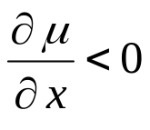
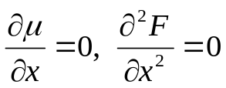
Chemical Potential of Mixtures
T<T_{C}
F
The primary thermodynamic variables: x, T, and μ = (∂F/∂x)_{T,V}. The variable x plays the same role for mixing that V plays for liquid-gas systems, while μ plays the role that pressure plays for liquid-gas systems.
0
x₁
x₂
1
x
μ
The discussion of phase separation in the mixture is very similar to our analysis of the liquid-gas separation in the vdW model (see Lect. 15). The chemical potential curve μ(x) looks like the curve μ(n) for the vdW gas.
0
x₁
x₂
1
x
T
homogeneous mixture (single liquid or solid phase)
There is a region of instability:
T_{C}
unstable
In the outer regions of metastability, droplets rich of one species have to be formed in a sea of the phase rich in the other majority species, but the interface cost poses a free energy barrier which the droplets have to overcome for further growth.
heterogeneous
mixture
(two separate
liquid or solid phases)
metastable
metastable
x₁(T)
x₂(T)
x

Slide 10
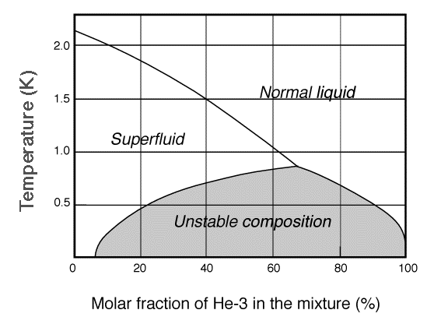
Liquid ³He-⁴He Mixtures at Low Temperatures
Mixtures of two helium isotopes ³He and ⁴He are used in dilution refrigerators. Also, it is a very interesting model system for various phase transitions (e.g., there is a so-called tricritical point on the phase diagram at which the lambda transition and the phase separation line meet).
The ³He-⁴He mixture has a solubility gap. The energy of mixing must be positive to have a solubility gap. The origin of the positive mixing energy is quantum-statistics-related.
lambda transition
phase separation
³He atoms are fermions, ⁴He atoms – bosons. ⁴He atoms occupy at low T the ground state with zero kinetic energy (“heavy vacuum” for ³He atoms). Almost the entire kinetic energy of the mixture is due to ³He atoms. The kinetic energy per atom of a degenerate Fermi gas increases with concentration as n ^{2/3}. On the other hand, due to its smaller mass, a ³He atom exhibits a larger zero-point motion than a ⁴He atom. As a result, a ³He atom will approach ⁴He atoms closer than it would approach ³He atoms, and, consequently, its binding to a ⁴He atom is stronger than a ³He - ³He bond. Because of the competition between K and U, the effective binding energy vanishes at a ³He concentration of 6.5% for T=0, and no further ³He can be dissolved in ⁴He.

Slide 11
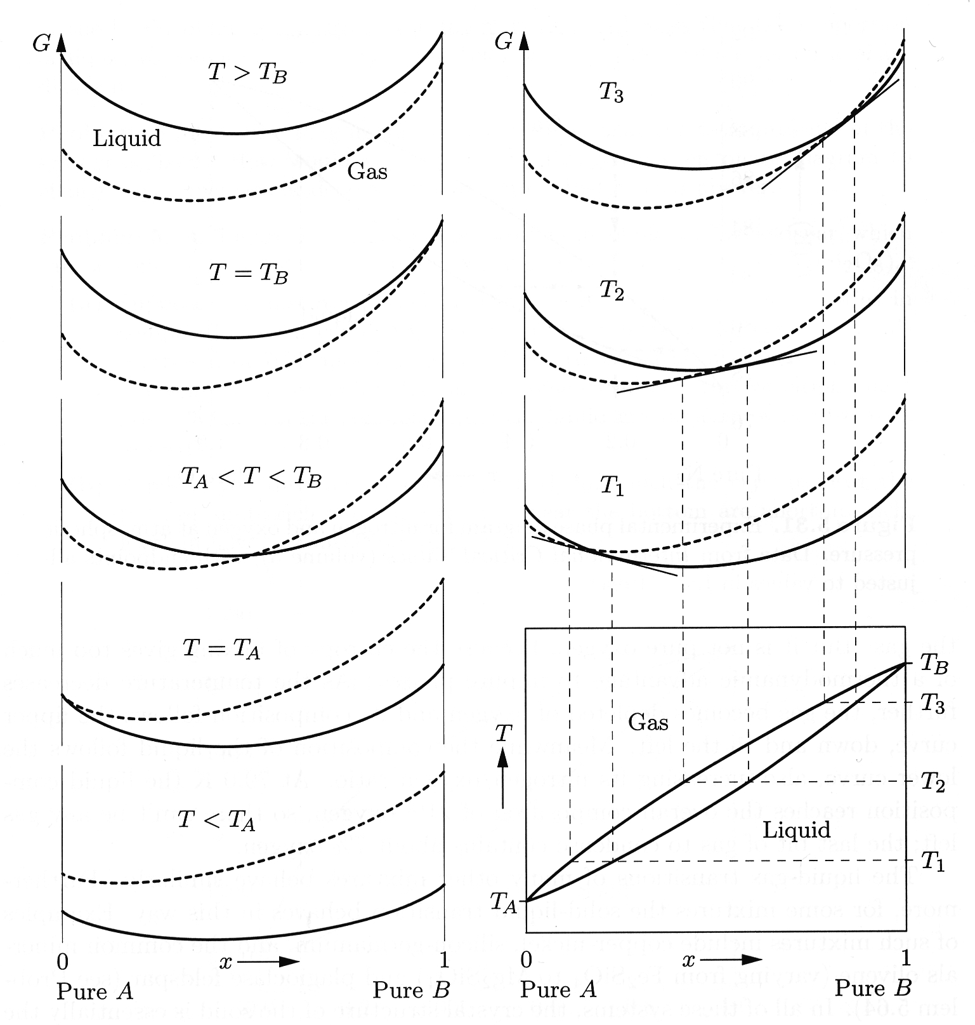
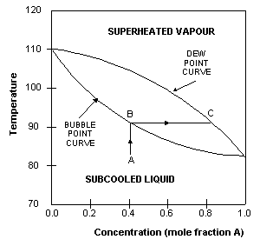
Phase Changes of a Miscible Mixture
T_{A} and T_{B} – the boiling temperatures of substances A and B .
At T > max(T_{A},T_{B} ), G_{gas} (x) < G_{liq} (x) for any x. With decreasing T, G_{gas} (x) decreases faster than G_{liq} (x) because of the –TS term. At T < min(T_{A},T_{B} ), G_{gas} (x) > G_{liq} (x) for any x.
The T-x phase diagram has a cigar-shaped region where the phase separation occurs. This shaded region is a sort of non-physical “hole” in the diagram – at each T, only points at the boundary of this region are physical points. If we heat up a binary mixture (we move up along the red line), the mixture starts boiling at T = T_{b1}, the liquid and gas phases will coexist in equilibrium until T is increased up to T = T_{b2} , and only above T_{b2}, the whole system will be in the gas phase. Thus, such a mixture doesn’t have a single boiling temperature. By varying T within the interval T_{b1} < T < T_{b2}, we vary the equilibrium concentration of components in gas and liquid.
The upper curve in the diagram is called the dew-point curve (the saturated vapor starts to condense), while the lower one is called the bubble-point curve.
T_{b2}
T_{b1}
A - less
volatile
substance
B - more
volatile
substance

Slide 12

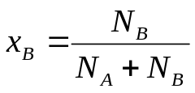

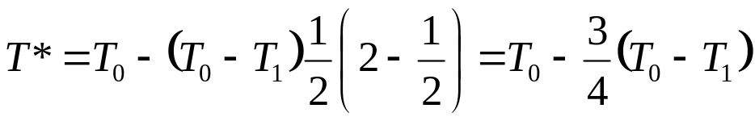
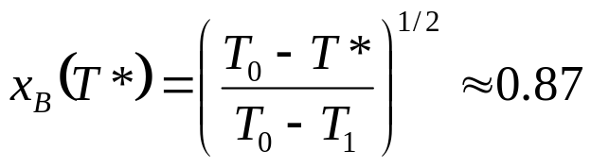
Problem:
The phase diagram of a solution of B in A, at a pressure of 1 bar, is shown in the Figure. The upper bounding curve (the dew-point curve) of the two-phase region can be represented by
T₀
T*
T₁
The lower bounding curve (the bubble-point curve) can be represented by
A
B
A beaker containing equal mole numbers of A and B is brought to its boiling temperature at the bubble-point curve. What is the composition of the vapor as it first begins to boil off? Does boiling tend to increase or decrease the mole fraction of B in the remaining liquid?
- boiling tend to decrease the mole fraction of B in the remaining liquid

Slide 13
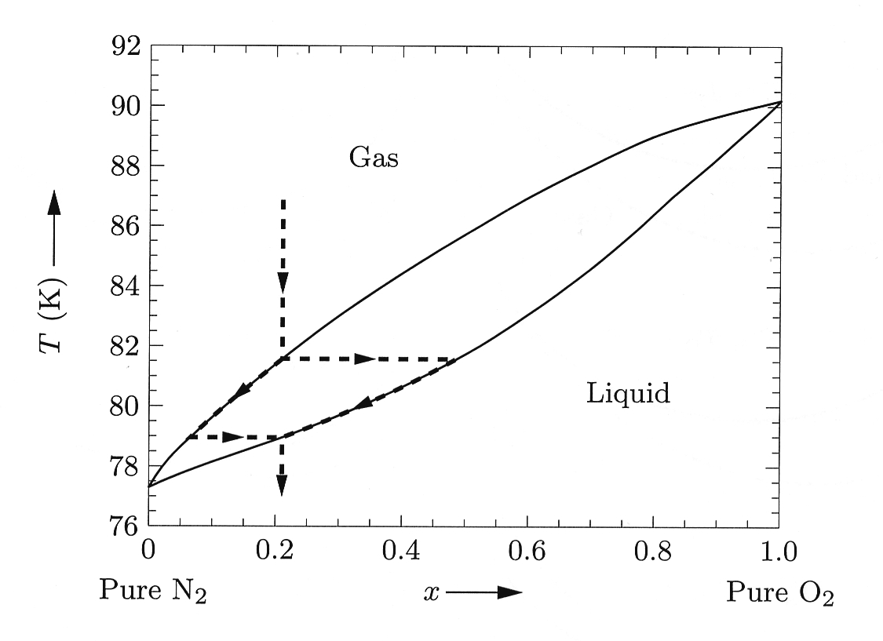
Liquefaction of Air
Air - mixture of oxygen (~21%) and nitrogen (~79%). At P = 1 bar, T_{N2} = 77.4 K and T_{O2} = 90.2 K. In the beginning of liquefaction at T = 81.6K, the liquid contains ~ 48% of oxygen. With decreasing T, the O₂ concentration in liquid decreases from 48% to 21%, while in gas – from 21% to 7%.
With increasing pressure, the character of this phase diagram changes. Above P = 33.5 bar, the critical pressure for N₂, the distinction between pure N₂ gas and pure N₂ liquid vanishes – the left end of the “cigar” moves to the right. Above the critical pressure for one of the components, the phase separation occurs only within the shaded region.
T (K)
0
x →
1
pure N₂
pure O₂

Slide 14



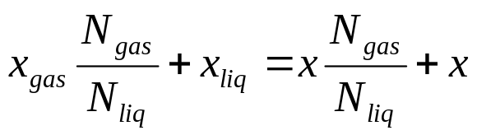
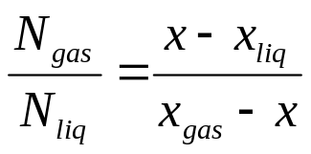
The Lever Rule
Pr. 5.62: Consider a completely miscible two-component system, the overall concentration of phase B is x. The temperature is fixed within the interval where gas and liquid phases coexist. What is the proportion of the gas phase to liquid phase?
At some T within the interval T_{b1} < T < T_{b2}, the concentration of phase B in gas is x_{gas}, in liquid - x_{liq}. If the total number of molecules in the gas phase is N_{gas} and in liquid - N_{liq}, then
The ratio of the total # of molecules in gas to the total # of molecules in liquid is the ratio of the lengths of the red and blue segments.
x_{gas}
x
x_{liq}

Slide 15
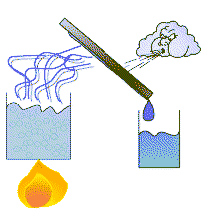
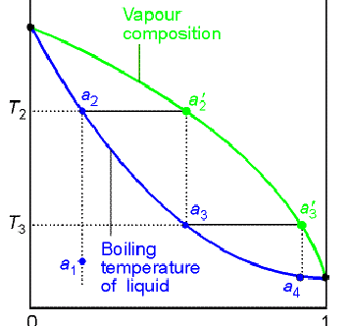
Physics of Distillation
This difference between liquid and vapor compositions is the basis for distillation - a process in which a liquid or vapor mixture of two or more substances is separated into its component fractions of desired purity, by the application and removal of heat.
In this example, component B is more volatile and therefore has a lower boiling point than A. For example, when a sub-cooled liquid with mole fraction of B=0.4 (point A) is heated, its concentration remains constant until it reaches the bubble-point (point B), when it starts to boil. The vapor evolved during the boiling has the equilibrium composition given by point C, approximately 0.8 mole fraction B. This is approximately 50% richer in B than the original liquid.
By extracting vapor which is enriched with a more volatile component, condensing the vapor, and repeating the process several times, one can get an almost pure substance (though most of the substance will be wasted in the purification process).
pure A
pure B

Slide 16
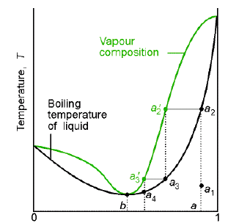
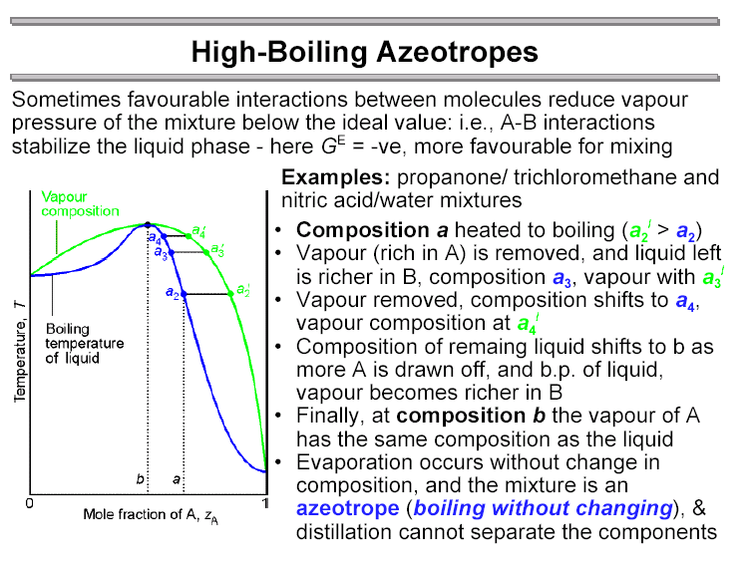
More Complicated Phase Diagrams
G
gas
Sometimes interactions between the molecules distort the phase diagram. If the liquid’s free energy is less concave than that of the gas, the curves can intersect in two places. Therefore, at this T, there are two composition ranges at which a combination of gas and liquid is more stable. At lower T, G of gas moves up faster than G of liquid due to the entropy difference, so the intersections move closer together until finally the two curves touch each other at a single point. The composition at this point is the so-called azeotrope; at this concentration, the mixture boils at a well-defined boiling temperature, just as a pure substance would.
liquid
T
gas
liquid
A
x →
B
Alternatively, if the gas free energy is less concave than that of the liquid, the phase diagram looks like the one on the right. In both cases, there is a limited range of concentrations at which purification by distillation is possible.
Low boiling azeotropes
(dioxane/H₂O, ethanol /H₂O)
High boiling azeotropes
(nitric acid/H₂O)

Slide 17
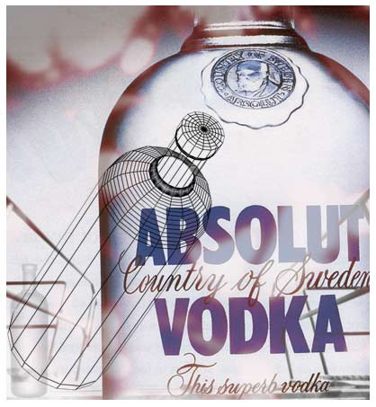

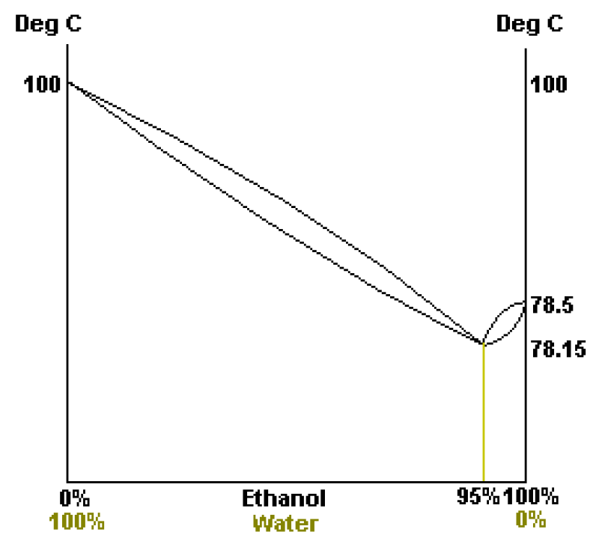
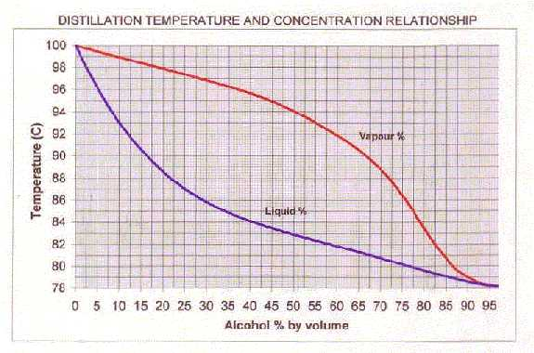
Water-Ethanol Mixture
For the water-ethanol mixture, the azeotrope concentration corresponds to ~95% of ethanol in the mixture. This is the limit that can be reached by distillation of a less-alcohol-rich mixture.

Slide 18
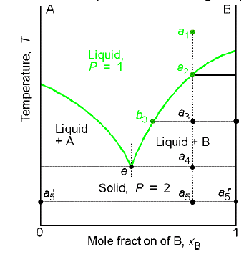
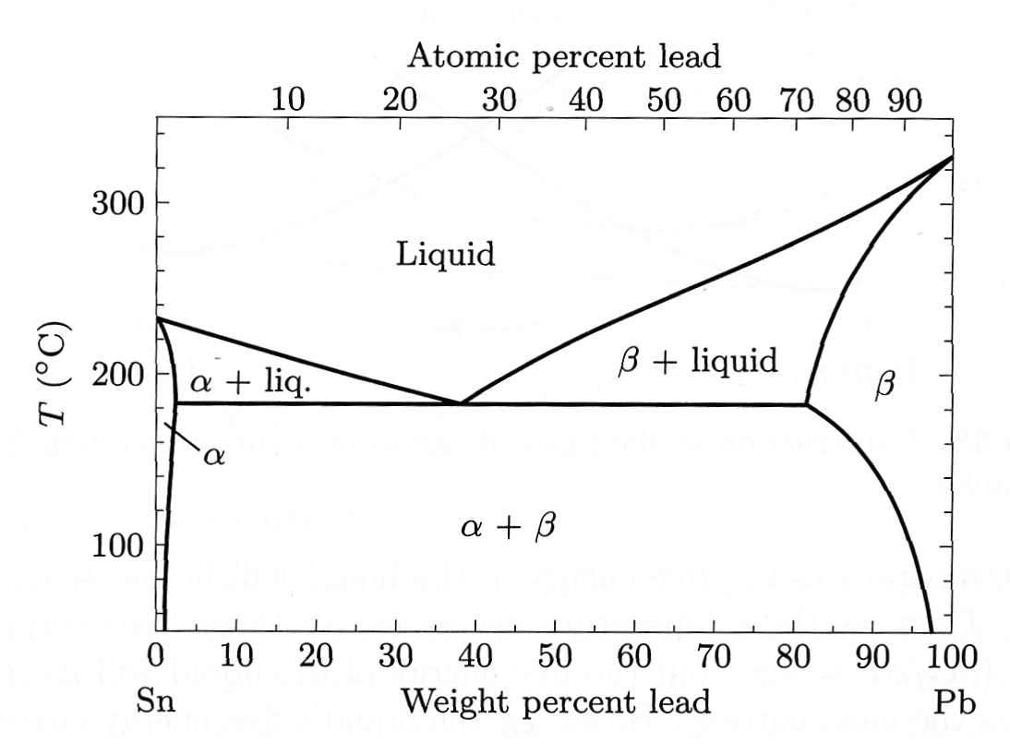

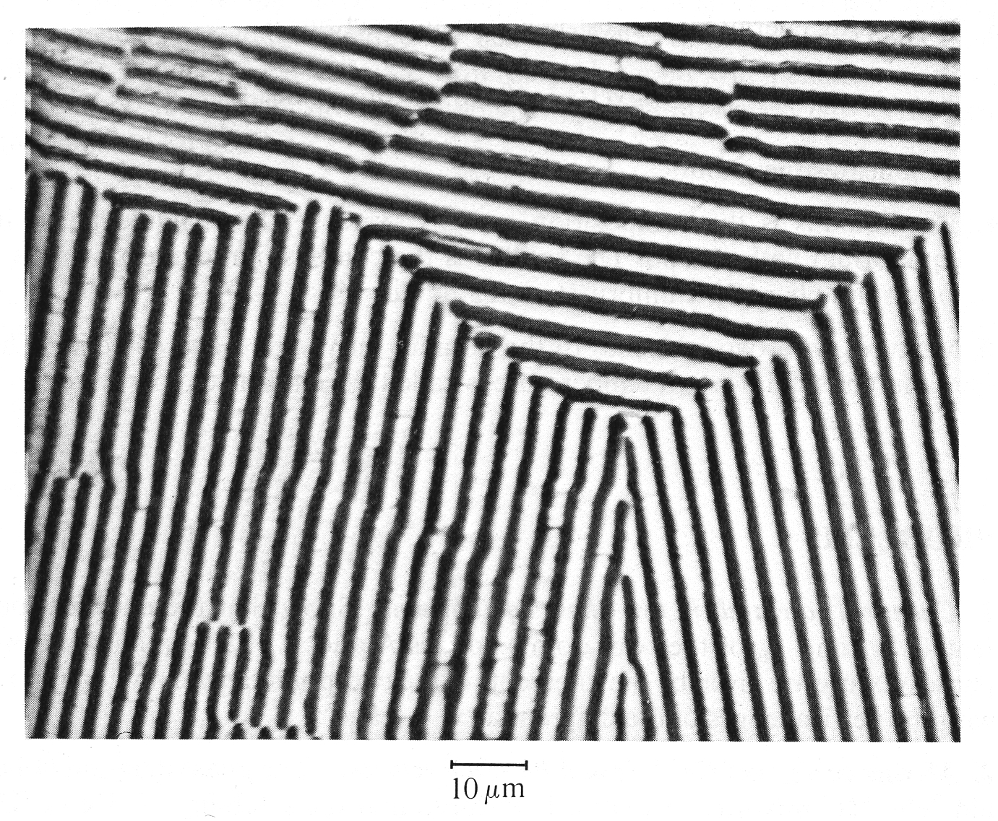
Example of a Heterogeneous Mixture: solids with different crystal structures
The properties of mixtures differ from the properties of pure subsatances. For example, the heterogeneous mixtures may melt at lower temperatures than their constituents (freezing point depression), or boil at elevated T (boiling point elevation).
pure A
pure B
Example: Phase diagram for mixtures of tin and lead. Number of components: k=2, number of coexisting phases:
α phase refers to a Sn structure with Pb impurities, β to the equivalent Pb structure, and α+ β to the solid-state alloy of the two. Pure Sn melts at 232⁰C, pure Pb – at 325⁰C, but an alloy of 62%Sn+38%Pb melts at 183⁰C. This is not the result of the formation of any low-melting Sn-Pb compound: the solidified mixture contains regions
of almost pure Sn side by side with almost pure Pb intermixed at a scale of ~1 micron. A mixture with eutectic (the lowest melting point) composition solidifies and melts at a single temperaure, just like a pure substance.
10 μm
Salt sprincled on ice melts the ice because of a low eutectic temperature –21.2⁰C of the H₂O-NaCl eutectic.
Microphotograph of the Pb-Sn eutectic

